Slide 1
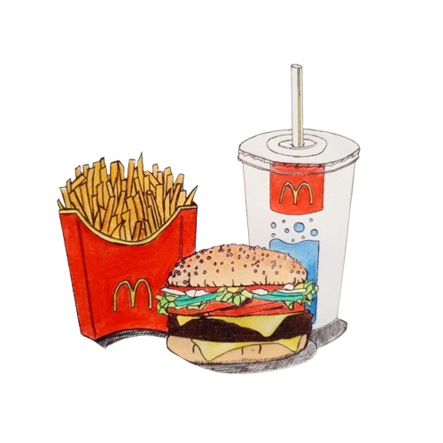
McDonalds
Strategic Assessment
Nidal Khan, Zoya Younis, Roohaan Dar, Umair Hussain

Slide 2
AGENDA
Company Overview & Key Issue
Recommendation
Internal Analysis
Implementation
External Analysis
Risks & Mitigation
Alternatives
Notes:
On our agenda today we will first be going over a Company Overview and Key Issue, then Internal Analysis, then External Analysis, then moving onto our Alternatives, then Recommendations. Lastly, we will conclude with our Implementation Plan

Slide 3

Overview
Overview & Key Issue
External
Internal
Alternatives
Recommendation
Implementation
Risks & Mitigation
Multinational fast-food chain which was founded in 1940 in San Bernardino, California.
Has over 38,000 locations in over 100 countries, over 1400 in Canada
Serves burgers, fries, milkshakes, ice cream, and more.
Notes:
McDonald's is a multinational fast-food chain which was founded by Dick & Mac McDonald, in 1940 in San Bernardino, California. To date, Mcdonald’s has over 38,000 locations in over 100 countries, with over 1400 being in Canada [1]. McDonalds serves burgers, fries, milkshakes, ice cream, and more.

Slide 4
Overview - Timeline
Overview & Key Issue
External
Internal
Alternatives
Recommendation
Implementation
Risks & Mitigation
1940
McDonald's founded by Dick and Mac McDonald
1968
Big Mac is added to the menu
1990
First McDonald's in Moscow is opened
2003
McDonald's “I’m lovin it” campaign is launched
2020
First net zero-designed restaurant launched
1955
Ray Krock opened the first McDonald’s franchise
1975
Egg McMuffin added to the menu
1993
First McCafe in the world is opened in Melbourne
2015
All day breakfast is launched in USA
Notes:
[2]

Slide 5
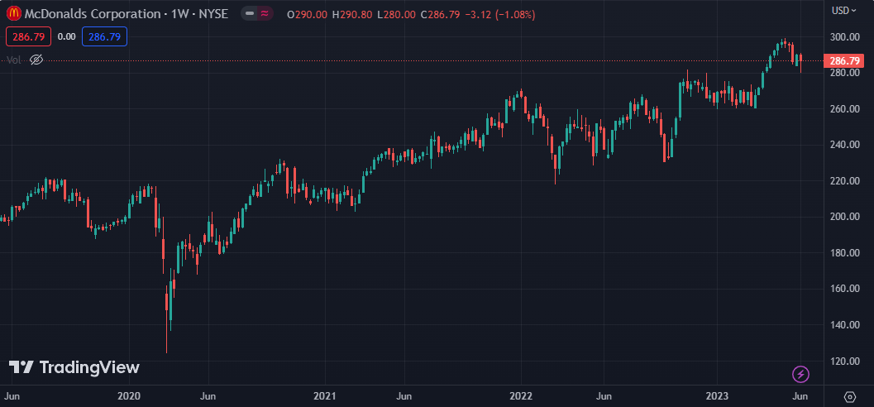
Overview - Stock Performance
Overview & Key Issue
External
Internal
Alternatives
Recommendation
Implementation
Risks & Mitigation
$298
$218
Please check notes below for description
$124
Notes:
McDonalds’ stock was around $218 in February 2020. Then during the crash in March 2020 price went down to $124. Price slowly recovered over the next few years and hit an all time high of $298.At the time of the screenshot McDonalds’ stock was trading at $286.[3]

Slide 6
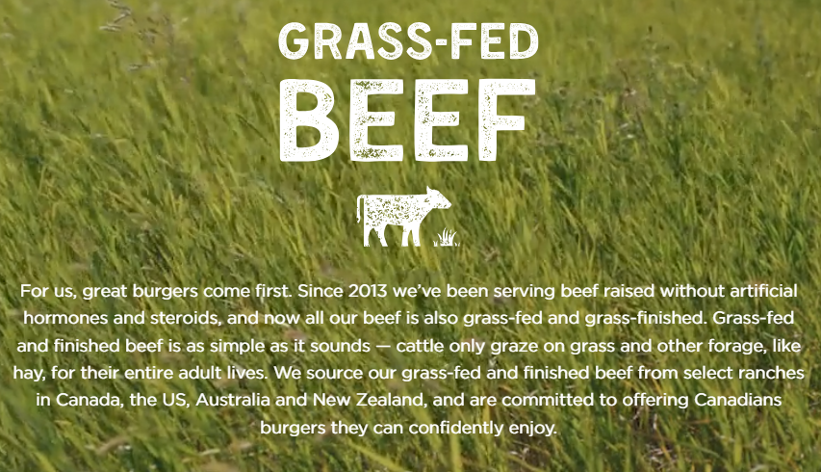
Key Issue
McDonalds offers some of the cheapest fast food on the market, but that results in poor quality and unhealthy food. McDonalds’ competitor, A&W, has started offering organic food items and grass-fed beef burgers which are healthier than conventional.
How can McDonald’s offer healthier food options while maintaining low prices and staying ahead of its competitors such as A&W and Burger King?
Overview & Key Issue
External
Internal
Alternatives
Recommendation
Implementation
Risks & Mitigation
Notes:
McDonalds offers some of the cheapest fast food on the market, but that results in poor quality and unhealthy food. McDonalds’ competitor, A&W, has started offering organic food items and grass-fed beef burgers which are healthier than conventional. With people becoming more health conscious, McDonalds should explore ways they can stay competitive. How can McDonald’s offer healthier food options while maintaining low prices and staying ahead of its competitors such as A&W and Burger King?

Slide 7
P5F - Bargaining Power of Supplier (Weak)
Overview & Key Issue
External
Internal
Alternatives
Recommendation
Implementation
Risks & Mitigation
Presence of numerous suppliers in the market
Mcdonald’s suppliers aren’t vertically integrated
Lack of integration reduces supplier bargaining power as they heavily rely on McDonald's and other food service businesses to reach the end consumers.
Notes:
Thank you Umair, so for the external analysis starting off with porter 5 forces, we’re gonna look at the Weak Bargaining power of Supplier (Weak Force)
The presence of numerous suppliers in the market weakens the individual influence of each supplier on McDonald's.
Moreover, most of McDonald's suppliers are not vertically integrated, meaning they do not have control over the distribution network that delivers their products to fast-food restaurants.

Slide 8
P5F - Bargaining Power of Buyer (Strong)
Overview & Key Issue
External
Internal
Alternatives
Recommendation
Implementation
Risks & Mitigation
Low switching costs for consumers gives them the ability to easily switch from one fast-food restaurant to another without incurring significant costs
Saturated market leaves numerous options for consumers
Consumers have access to various substitutes such as food kiosks, artisanal bakeries, microwave meals, and home-cooked food⁴
Notes:
Next is the strong Bargaining power of Buyers (Strong Force)
Consumers have low switching costs, giving them the ability to easily switch from one fast-food restaurant to another without incurring significant costs.
Furthermore, The market is saturated with numerous options for consumers.
Lastly, In addition to other fast-food restaurants, consumers have access to various substitutes that provide them with flexibility and contribute to their strong bargaining power.

Slide 9
P5F - Threat of Substitutes (Strong)
Overview & Key Issue
External
Internal
Alternatives
Recommendation
Implementation
Risks & Mitigation
There are many alternatives to Mcdonald’s products (Artisanal food producers, local bakeries, and homemade meals)⁴
For consumers shifting from Mcdonald’s to substitutes is relatively easy and convenient
Many substitutes are becoming more competitive by offering low cost-performance ratio
Notes:
Next we need to take into account the Strong Threat of Substitutes (Strong Force)
Firstly, there is a high availability of substitutes, which intensifies the threat. Secondly, the low switching costs for consumers further enhances the threat.
There are minimal disadvantages involved, such as additional time for food preparation or slightly higher costs per meal in some cases, making it effortless for consumers to switch.
Lastly, many substitutes offer a low cost-performance ratio, making them competitive in terms of quality and customer satisfaction.
Considering these factors the threat of substitutes is a major strategic concern for McDonald's Corporation.

Slide 10
P5F - Threat of New Entrants (Moderate)
Overview & Key Issue
External
Internal
Alternatives
Recommendation
Implementation
Risks & Mitigation
High capital costs are required in establishing a new restaurant business
Building a strong brand in the fast food industry also requires substantial amounts of cash
Notes:
Next is the Moderate Threat of New Entrants (Moderate Force)
The high capital costs required in establishing a new restaurant business presents a moderate barrier to entry. While it can limit the entry of some new businesses, it is not a significant deterrent for all potential entrants.
Furthermore, building a strong brand in the fast-food industry comes with high costs. Many small and medium-sized businesses lack the necessary resources to establish a brand that can compete with McDonald's.

Slide 11
P5F - Rivalry Amongst Existing Competitors (Strong)
Overview & Key Issue
External
Internal
Alternatives
Recommendation
Implementation
Risks & Mitigation
Large number of fast food firms in the industry
Medium and large companies actively engage in aggressive marketing of their good and beverage products striving to gain a competitive edge
Low switching costs between restaurants exert a strong force on competitive rivalry.
Notes:
Lastly, we’re going to look at the Strong Rivalry Amongst Existing Competitors (Strong Force)
Firstly, there is a high number of food service firms in the industry. This factor contributes to the strong force of competitive rivalry within the fast-food industry.
Secondly, the high aggressiveness of firms in the market amplifies the force of competition. Various companies actively engage in aggressive marketing of their food and beverage products, striving to gain a competitive edge.
Lastly, low switching costs between restaurants exert a strong force on competitive rivalry.
Overall, competitive rivalry stands as a dominant force that McDonald's must address in its strategic management.

Slide 12

P.E.S.T Analysis
Overview & Key Issue
External
Internal
Alternatives
Recommendation
Implementation
Risks & Mitigation
Stricter Governmental Guidelines for Diet and Health
Evolving Public health policies
P
E
Economic conditions and Consumer spending power
Fluctuations in commodity prices
Changing consumer preferences and lifestyles
Increasing awareness of the environmental impact of food production and packaging
S
T
Use of Automation and robotics
Digitalization and mobile technology
Notes:
Next we’re going to look at the PEST analysis for Mcdonald's. The political factors include stricter governmental guidelines for diet and health as well as evolving public health policies.
Economic factors include economic conditions and consumer spending power, as well as fluctuations in commodity prices.
Social factors include Changing consumer preferences and lifestyles as well as Increasing awareness of the environmental impact of food production and packaging.
Lastly technological factors induce Use of Automation and robotics as well as Digitalization and mobile technology.

Slide 13
Political Factors
Overview & Key Issue
External
Internal
Alternatives
Recommendation
Implementation
Risks & Mitigation
Stricter Governmental Guidelines for Diet and Health
Governments around the world have been implementing stricter guidelines and regulations related to food, diet, and health. This includes measures like mandatory calorie labeling, restrictions on advertising to children, and requirements for nutritional information disclosure. McDonald's needs to comply with these guidelines and adjust its menu offerings and marketing strategies accordingly.
Evolving Public health policies
Public health policies, such as initiatives to reduce obesity rates, promote healthier eating habits, and combat non-communicable diseases, can impact the fast-food industry. Governments may introduce taxes on unhealthy food items or implement marketing restrictions on high-calorie products. McDonald's needs to monitor and adapt to these evolving policies to align with public health goals.

Slide 14
Economic Factors
Overview & Key Issue
External
Internal
Alternatives
Recommendation
Implementation
Risks & Mitigation
Economic conditions and Consumer spending power
McDonald's, being a global fast-food chain, is affected by the economic conditions in different countries. Factors such as GDP growth, inflation rates, unemployment rates, and exchange rates can impact consumer spending patterns and overall profitability.
The disposable income of consumers plays a significant role in determining their spending on fast food. During economic downturns, consumers may cut back on discretionary expenses, including eating out, which can affect McDonald's sales.
Fluctuations in commodity prices
McDonald's heavily relies on commodities like beef, poultry, potatoes, and cooking oil. Fluctuations in the prices of these commodities can impact the company's cost of goods sold and, subsequently, its profitability.

Slide 15
Social Factors
Overview & Key Issue
External
Internal
Alternatives
Recommendation
Implementation
Risks & Mitigation
Changing consumer preferences and lifestyles
Consumers' tastes and preferences are constantly evolving. McDonald's needs to adapt to changing trends and demands by offering healthier menu options, accommodating dietary restrictions, and addressing concerns about sustainability and ethical sourcing.
Increasing awareness of the environmental impact of food production and packaging
Consumers today are more conscious of the environmental impact of food production and packaging. McDonald's has responded by adopting sustainable practices such as reducing packaging waste, using renewable energy, and sourcing ingredients responsibly. Addressing these concerns is crucial for maintaining and enhancing the brand's reputation.

Slide 16
Technological Factors
Overview & Key Issue
External
Internal
Alternatives
Recommendation
Implementation
Risks & Mitigation
Use of Automation and robotics
McDonald's has been exploring the use of automation and robotics in its operations to improve efficiency, reduce costs, and enhance customer experience. This includes self-ordering kiosks, automated beverage dispensers, and kitchen automation systems.
Digitalization and mobile technology
McDonald's has been investing in digitalization and mobile technology to enhance convenience for customers. This includes mobile ordering and payment apps, delivery partnerships with online platforms, and loyalty programs. Embracing digital technology is essential for staying competitive and meeting the expectations of tech-savvy consumers.

Slide 17
SWOT ANALYSIS
Strengths
Opportunities
Weaknesses
Threats
Overview & Key Issue
External
Internal
Alternatives
Recommendation
Implementation
Risks & Mitigation
Real Estate Holding[7][9]
Technological Advancements[10]
Quality Control[8]
Vegetarian Popularity[13]
International Expansion[11]
Delivery Expansion
Healthy Food[12]
Supply Chain
Employee Satisfaction
Rising competitors
Strict Laws
Health Consciousness
Notes:
SWOT McDonald’s
McDonald’s has many strengths, but today we will be discussing the following 3, its real estate holdings, its technological advancements, and the quality control.
Strength:
Real Estate Company
There are over 36,000 McDonalds locations worldwide. Of which McDonalds owns 45% of the land and 70% of the building. In 2021 McDonalds reported $41.9 billion worth of assets. Of which real estate accounted for $38.4 billion and $3.5 billion for equipment. Real estate also plays a substantial role in McDonalds revenue. In 2014 McDonalds reported $27.4 billion in revenue, of which rent from franchised locations accounted for $9.2 billion and $18.2 billion from company operated restaurants. The benefit of collecting rent is the higher profit margins. On stores that are franchised, McDonalds keeps about 82% of revenue compared to 16% of revenue of company operated stores.[7][9]
Technological Advancements
The second strength for McDonalds is its recent advancements into technology. Previously McDonald utilized technology to implement self-service kiosks, drive thrus, and mobile ordering. McDonalds has now introduced robot only drive through. McDonalds also created a Digital Information Team who use technology to overcome challenges.[10]
Quality Control
The last strength for McDonalds is its quality control. McDonalds upholds strict standards for their food. Produce is regularly checked for freshness, and quality. Minimal use of chemicals is used alongside frequent checks for bacteria. For livestock the farms are kept clean with access to food, water and trained employees. McDonalds also has programs like Hazard Analysis and Critical Control Point (HACCP) and Good Manufacturing Practice (GMP).[8]
Weakness:
Lack of healthy food
McDonalds lacked variety in healthy options. But recently McDonalds has decided to trim their menu and the items at the top of the list were healthier options. The reason McDonalds is choosing to trim their menu is because with less items, they expect wait times to decrease.[12]
Supply Chain
Since McDonalds is a large fast-food chain its supply chain needs to be perfect for all restaurants around the world to get their items in time. If there are supply chain disruptions it increases the costs which leads to reduced revenues.
Employee Satisfaction
Many McDonald employees are not happy leading to multiple strikes. Employees complain that they are not paid enough, are not given enough hours and do not get treated with respect. This creates a bad impression on the public on how McDonalds operates as a business.
Opportunity:
Vegetarian Popularity
Vegetarian and vegan foods have started to gain mainstream popularity. In recent years many people are trying vegetarian diets or completely switching to vegetarianism. [13]
International expansion
As third world countries continue to develop, their residents earn more money. This means that there is an increasing amount of the population with disposable income to spend on fast food restaurants. McDonalds expansion into third world countries can now be lucrative due to the rising economies. [11]
Delivery Expansion
With recent rise to food delivery apps, McDonald's could either offer their own delivery service to customers. Another option McDonalds would have is to partner exclusively with a food delivery app. Since McDonalds is a significant restaurant franchise they can get favourable terms on the food delivery apps.
Threats:
Increasing competition
McDonalds had an advantage over its competitors because of its first mover’s advantage. But as time has passed on, there are more and more fast-food restaurants opening, increasing the competition for McDonalds.
Strict Laws
Many countries around the globe have strict rule restricting McDonalds from opening a fast-food restaurant. This hinders McDonalds in opening a fast-food restaurant in these countries. Some of these countries have banned McDonalds due to health reasons while others have banned McDonalds due to political reasons.
Health Consciousness
Many consumers are becoming self conscious about the food that they are eating. This is due to increased awareness on social media of how unhealthy McDonalds food is and with documentaries such as ‘Super Size Me’ releasing. With McDonalds not providing healthy alternatives, some customers may choose to skip on McDonalds.

Slide 18
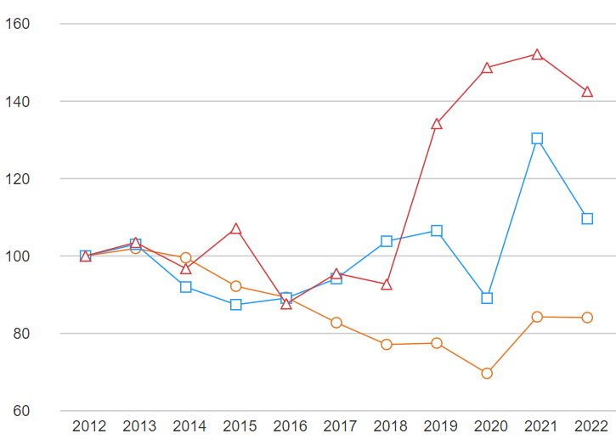
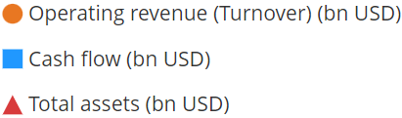
FINANCIAL ANALYSIS
Overview & Key Issue
External
Internal
Alternatives
Recommendation
Implementation
Risks & Mitigation
Notes:
Cash Flow and Total Assets peaked in 2021, and had a sharp decline in 2022. With Operating revenue there has been a steady decline since 2012. This means that McDonalds has been doing good until 2021 but started a decline in 2022. If this trend continues McDonald's will continue to lose market share. [14] The reason we chose to look at total assets is because as mentioned earlier McDonald's own much of the land and the building that franchisees operate on. With decrease in total assets this means that there is a decrease in the amount of McDonald's stores. This is also why operating revenue and cash flow are important for McDonalds because they need money to buy all of the land and to build the restaurants. Since McDonalds only opens restaurants in the best locations, the land is expensive.
https://orbis-r1-bvdinfo-com.ezproxy.lib.ucalgary.ca/version-20230324-3-3/Orbis/1/Companies/report/Index?backLabel=Back%20to%20Key%20financials%20%26%20employees&refreshTopPos=4.800000190734863&format=BB5BC326-AF8D-4D86-B140-3967E9D458C3&BookSection=A0F7E37C-601F-46CD-ADA0-F41B55A190E6&seq=0&sl=1686547463354&back=true

Slide 19
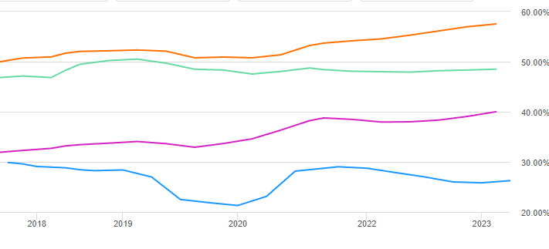
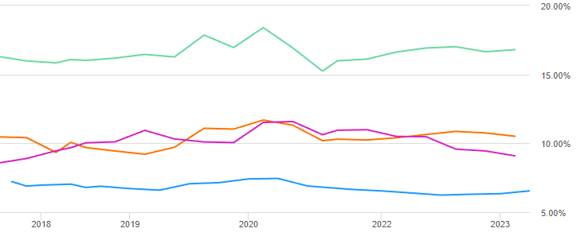
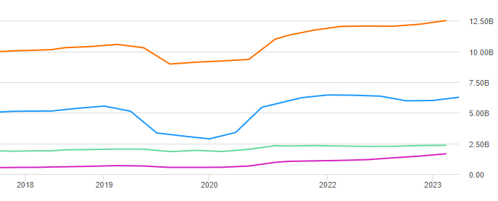
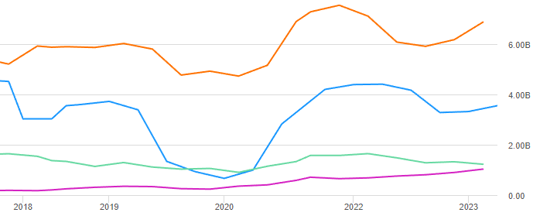
FINANCIAL ANALYSIS
Overview & Key Issue
External
Internal
Alternatives
Recommendation
Implementation
Risks & Mitigation
Gross Profit Margin
SG&A Margin
EDITDA
Net Income
Notes:
These charts compare McDonalds to some of its competitors.
In Orange we have McDonalds, Blue we have Starbucks, Pink is Chipotle, and Green is YUM which owns multiple companies such as KFC, Pizza Hut, Taco Bell, and The Habit Burger Grill. We will compare multiple aspects of these companies over a 5 year period.
When comparing the Gross Profit Margin between these companies. It is evident that McDonalds is doing the best, while Starbucks is doing the worst. YUM comes in second following closely behind McDonalds.[15]
When comparing the SG&A Margin, the story is a little different. In this scenario YUM is at the top while McDonalds and Chipotle are about the same.[15]
When comparing EBITDA McDonalds is the highest with Starbucks being second. Compared to its competitors McDonalds has a large lead. [15]
If we were to look at the Net Income for everyone, we can see that it isn't only McDonalds that had the rise and fall from 2021. Starbucks also follows McDonalds trend. Not only that but similar to other indicators McDonalds is once again leading with the highest Net Income.[15]

Slide 20

Alternatives
Partnerships & Collaborations
Menu Diversification
Automation for Healthier Food Prep
Overview & Key Issue
External
Internal
Alternatives
Recommendation
Implementation
Risks & Mitigation

Slide 21
Alternative 1: Partnerships & Collaborations
Overview & Key Issue
External
Internal
Alternatives
Recommendation
Implementation
Risks & Mitigation
Strategic partnerships with nutritionists, dietitians, health organization to gain credibility and develop healthier food option
Collaborating with local suppliers such as Safeway, Freshco, Superstore to incorporate fresh ingredients in the meal offerings
Some examples for partnerships: World Health Organization (WHO) & Clinton Foundation (see notes)
Notes:
Partnerships and Collaborations:
McDonald's can establish partnerships and collaborations with reputable nutrition organizations, government agencies, and public health experts to promote healthier lifestyles and educate consumers about balanced diets. The collaborations can involve joint campaigns, educational initiatives, and the development of new menu items that meet specific health criteria, such as reduced sodium or increased vegetable content.
For example, McDonald's could partner with organizations like the American Heart Association, Academy of Nutrition and Dietetics, or World Health Organization to co-create educational materials, provide nutritional guidance, and conduct public awareness campaigns. These partnerships can be structured as long-term collaborations, with regular evaluations and updates on progress and outcomes. By working with recognized nutrition organizations, McDonald's can enhance its credibility and demonstrate a genuine commitment to addressing public health concerns.
“This is a particular opportunity to partner with the Clinton Foundation and the alliance to leverage our scale and size and marketing prowess to be able to influence more purchases of fruits and vegetables,” https://www.nytimes.com/2013/09/27/business/mcdonalds-moves-toward-a-healthier-menu.html

Slide 22
Alternative 2: Menu Diversification
Overview & Key Issue
External
Internal
Alternatives
Recommendation
Implementation
Risks & Mitigation
Conduct market research to understand customer preferences and identity potential gaps
Menu analysis: evaluation of current menu- spot for any areas where healthier options can be introduced
By emphasizing the quality and nutritional value of their ingredients, McDonald's can enhance the appeal of their healthier offerings.
Notes:
- This would include an extensive market research to understand customer preferences and identity potential gaps in the market. It would also require an in depth menu analysis to evaluate current menu offerings and identity room for improvement. Looking for areas where healthier options can be introduced or existing items can be modified to improve their nutritional profile
-McDonald's can also focus on sourcing high-quality ingredients for its healthier options. This can involve using lean proteins, fresh fruits and vegetables, whole grains, and reducing artificial additives, preservatives, and trans fats. By emphasizing the quality and nutritional value of their ingredients, McDonald's can enhance the appeal of their healthier offerings.
Differentiation From Alternative 1:
Menu Diversification:
This alternative involves actively revising the recipes and composition of McDonald's existing menu items. The focus is on reducing calorie, fat, salt, and sugar content while maintaining taste and quality. Additionally, The primary objective is to internally improve the nutritional profile of McDonald's offerings. This requires investment in research and development to explore alternative ingredients and cooking methods. By reformulating menu items, McDonald's directly addresses the key issue of providing healthier options.
Partnerships and Collaborations:
This alternative involves establishing partnerships with nutrition organizations, government agencies, and public health experts. The focus is on joint campaigns, educational initiatives, and the development of new menu items that meet health criteria. The primary objective is to collaborate externally to promote healthier lifestyles and educate consumers. It requires identifying relevant organizations and creating mutually beneficial partnerships such as American Heart Association, Academy of Nutrition and Dietetics, or World Health Organization. By partnering with external entities, McDonald's enhances its credibility and demonstrates a proactive approach to public health concerns. In summary, the "Menu Diversification" alternative involves making internal changes to the composition of McDonald's menu items, directly targeting the nutritional content. On the other hand, the "Partnerships and Collaborations" alternative involves external collaborations to promote healthier choices and educate consumers.

Slide 23
Alternative 3: Automation for Healthier Food Preparation
Overview & Key Issue
External
Internal
Alternatives
Recommendation
Implementation
Risks & Mitigation
By implementing advanced technology and automation systems, McDonald's can ensure consistency in cooking methods, portion control, and the reduction of excess fattening cooking oil and unhealthy portions of sauces.
Provides consistency in cooking
Reducing human error
Notes:
One alternative for McDonald's to address the key issue of providing healthier food options is to leverage automation in their food preparation processes. By implementing advanced technology and automation systems, McDonald's can ensure consistency in cooking methods, portion control, and the reduction of excess fattening cooking oil and unhealthy portions of sauces. This alternative focuses on utilizing automation to improve the overall quality and healthiness of McDonald's menu offerings.
Consistency in Cooking:
Automation systems can be programmed to follow standardized cooking procedures, ensuring consistent cooking times and temperatures for various menu items. This consistency eliminates the risk of undercooked or overcooked food, leading to healthier and safer meals. By automating the cooking process, McDonald's can reduce the likelihood of excessive frying or the use of unhealthy oils, resulting in healthier food options for customers.
Reduced Human Error:
Automation minimizes the potential for human error in food preparation. This reduces the risk of mistakes such as using incorrect ingredients, over-pouring sauces, or unevenly spreading toppings. By relying on automated systems, McDonald's can ensure that each order is prepared consistently and accurately, minimizing the chances of serving unhealthy or improperly prepared meals to customers.

Slide 24

Decision Criteria
Overview & Key Issue
External
Internal
Alternatives
Recommendation
Implementation
Risks & Mitigation
 | Partnerships & Collaborations | Menu Diversification | Automation For Healthier Food Prep.
Increased Healthy Offerings
Increase In Profits
Competitiveness

Slide 25
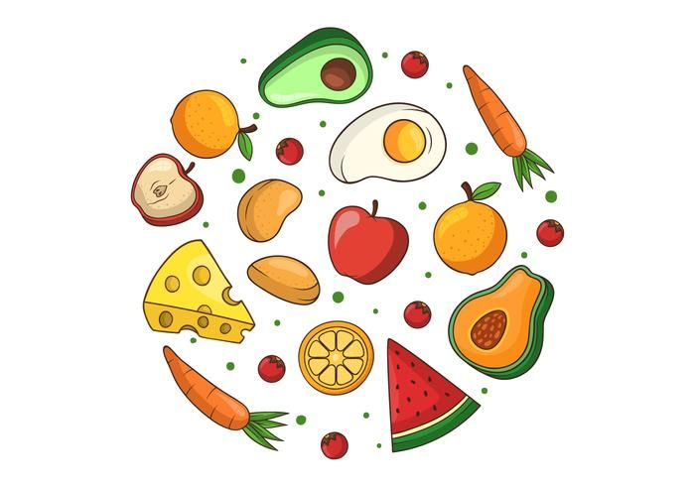
Decision / Recommendation
Overview & Key Issue
External
Internal
Alternatives
Recommendation
Implementation
Risks & Mitigation
Diversify Menu
This will target a broader market
Differentiation from competitors
Mcdonald’s can include gluten-free, plant-based, beyond meat and much more!
This will ensure that Mcdonald’s continues to dominates in the marketplace along with offering healthier options for those health conscious individuals
Evolve consumer demands

Slide 26

Implementation
Overview & Key Issue
External
Internal
Alternatives
Recommendation
Implementation
Risks & Mitigation
Menu Diversification
1.Market research - customer preference
2.Evaluating current menu offerings / modification
Step 1
3. Introduce Plant-Based Alternatives, such as Beyond Meat in select locations while analyzing consumer feedback
4. Plan to introduce alternatives and modifications throughout all stores after adjustments
Increase Healthier Options to target a broader market
Step 2
Notes:
Step 1: Market Research - Customer Preference
Step 2: Evaluating Current Menu Offerings / Modification
Step 3: Introduce Plant-Based Alternatives in Select Locations and Analyze Consumer Feedback
Step 4: Plan to Introduce Alternatives and Modifications Throughout All Stores After Adjustments

Slide 27
Implementation
Overview & Key Issue
External
Internal
Alternatives
Recommendation
Implementation
Risks & Mitigation
Step 1: Market Research - Customer Preference
In this step, McDonald's would conduct comprehensive market research to gain insights into customer preferences regarding healthier menu options. This research would involve surveys, focus groups, and data analysis to understand consumer trends, dietary preferences, and demands for plant-based alternatives. McDonald's would also gather information on nutritional requirements, dietary restrictions, and taste preferences. This research would guide the development of new menu items and modifications to existing offerings that cater to customer demands.
Notes:
Step 1: Market Research - Customer Preference
In this step, McDonald's would conduct comprehensive market research to gain insights into customer preferences regarding healthier menu options. This research would involve surveys, focus groups, and data analysis to understand consumer trends, dietary preferences, and demands for plant-based alternatives. McDonald's would also gather information on nutritional requirements, dietary restrictions, and taste preferences. This research would guide the development of new menu items and modifications to existing offerings that cater to customer demands.

Slide 28
Implementation
Overview & Key Issue
External
Internal
Alternatives
Recommendation
Implementation
Risks & Mitigation
Step 2: Evaluating Current Menu Offerings / Modification
In this step, McDonald's would assess its current menu offerings to identify areas where modifications can be made to introduce healthier options. This evaluation would involve a thorough analysis of ingredients, cooking methods, and nutritional content. McDonald's would work closely with nutritionists and culinary experts to identify opportunities for improvement. The goal would be to enhance the nutritional profile of existing menu items by reducing unhealthy ingredients, controlling portion sizes, and incorporating more nutritious ingredients.
Notes:
Step 2: Evaluating Current Menu Offerings / Modification
In this step, McDonald's would assess its current menu offerings to identify areas where modifications can be made to introduce healthier options. This evaluation would involve a thorough analysis of ingredients, cooking methods, and nutritional content. McDonald's would work closely with nutritionists and culinary experts to identify opportunities for improvement. The goal would be to enhance the nutritional profile of existing menu items by reducing unhealthy ingredients, controlling portion sizes, and incorporating more nutritious ingredients.

Slide 29
Implementation
Overview & Key Issue
External
Internal
Alternatives
Recommendation
Implementation
Risks & Mitigation
Step 3: Introduce Plant-Based Alternatives in Select Locations and Analyze Consumer Feedback
To target a broader market and meet the growing demand for plant-based options, McDonald's would introduce plant-based alternatives, such as the Beyond Meat, in select locations. This would allow the company to gauge consumer response and gather feedback regarding taste, quality, and satisfaction with these new offerings. McDonald's would closely monitor customer feedback through surveys, social media, and direct interactions to assess the success and acceptance of plant-based alternatives.
Notes:
Step 3: Introduce Plant-Based Alternatives in Select Locations and Analyze Consumer Feedback
To target a broader market and meet the growing demand for plant-based options, McDonald's would introduce plant-based alternatives, such as the Beyond Meat, in select locations. This would allow the company to gauge consumer response and gather feedback regarding taste, quality, and satisfaction with these new offerings. McDonald's would closely monitor customer feedback through surveys, social media, and direct interactions to assess the success and acceptance of plant-based alternatives.

Slide 30
Implementation
Overview & Key Issue
External
Internal
Alternatives
Recommendation
Implementation
Risks & Mitigation
Step 4: Plan to Introduce Alternatives and Modifications Throughout All Stores After Adjustments
Based on the consumer feedback and performance of plant-based alternatives in select locations, McDonald's would refine and adjust its menu diversification strategy. This would involve analyzing the data collected from consumer feedback and identifying areas for improvement. McDonald's would work closely with suppliers to ensure the availability and consistent quality of plant-based ingredients. Once adjustments have been made and any necessary modifications to recipes and cooking processes have been implemented, McDonald's would roll out the introduction of alternatives and modifications across all its stores. This comprehensive implementation plan would ensure that customers nationwide have access to a diverse and healthier menu.
Notes:
Step 4: Plan to Introduce Alternatives and Modifications Throughout All Stores After Adjustments
Based on the consumer feedback and performance of plant-based alternatives in select locations, McDonald's would refine and adjust its menu diversification strategy. This would involve analyzing the data collected from consumer feedback and identifying areas for improvement. McDonald's would work closely with suppliers to ensure the availability and consistent quality of plant-based ingredients. Once adjustments have been made and any necessary modifications to recipes and cooking processes have been implemented, McDonald's would roll out the introduction of alternatives and modifications across all its stores. This comprehensive implementation plan would ensure that customers nationwide have access to a diverse and healthier menu.

Slide 31
Risks & Mitigation
Overview & Key Issue
External
Internal
Alternatives
Recommendation
Implementation
Risks & Mitigation
Negative Consumer Response to Taste | Recipe Development and Testing
Operational Complexity | Streamlined Supply Chain & Efficient Training
Competitive Response | Ongoing Research and Development
Notes:
Risk 1. Negative Consumer Response to Taste
Consumers may perceive the healthier menu options as lacking in flavor or not meeting their taste expectations, leading to decreased interest and sales.
Mitigation for Risk 1. Recipe development and Testing:
McDonald's should invest in extensive recipe development and testing to ensure that the healthier menu options are flavorful, appealing, and meet customers' taste preferences. This can involve working with professional chefs, culinary experts, and conducting taste tests with target consumers to refine the recipes.
Risk 2. Operational Complexity:
The introduction of new menu items and the need for sourcing high-quality ingredients may add complexity to McDonald's operations, leading to challenges in supply chain management and increased costs.
Mitigation for Risk 2. Streamlined Supply Chain:
McDonald's can establish partnerships with trusted suppliers to ensure a consistent and reliable supply of high-quality ingredients for their healthier menu options. This involves conducting thorough supplier assessments and implementing strict quality control measures.
Efficient Training and Processes:
McDonald's can invest in training programs for employees to ensure they are equipped to handle the preparation and service of the new menu items. Additionally, streamlining processes and optimizing kitchen layouts can help manage increased complexity and maintain operational efficiency.
Risk 3. Competitive Response:
Competitors may react by also introducing healthier menu options, reducing the differentiating factor for McDonald's.
Mitigation Risk 3. Ongoing Research and Development:
McDonald's should continuously invest in research and development to stay ahead of competitors. This involves monitoring market trends, consumer preferences, and nutritional advancements to introduce innovative and unique menu items that differentiate McDonald's from its competitors.

Slide 32
Thank you!
Any questions?

Slide 33
References
Our history | mcdonalds Canada. (n.d.). Retrieved July 16, 2023, from https://www.mcdonalds.com/ca/en-ca/about-us/our-history.html
McDonald’s history. (n.d.). Retrieved July 16, 2023, from https://corporate.mcdonalds.com/corpmcd/our-company/who-we-are/our-history.html
Tradingview. TradingView. (n.d.). Retrieved July 16, 2023, from https://www.tradingview.com/
Gregory, L. (2022, June 22). McDonald’s five forces analysis (Porter’s Model). (n.d.) Retrieved July 16, 2023, from https://panmore.com/mcdonalds-five-forces-analysis-porters-model
McDonald’s new strategy toward Healthy Food - 1928 words: Essay example. Free Essays. (n.d.). Retrieved July 16, 2023, from https://ivypanda.com/essays/mcdonalds-new-strategy-toward-healthy-food/
Strom, S. (2013, September 26). With tastes growing healthier, McDonald’s aims to adapt its menu. The New York Times. Retrieved July 16, 2023, from https://www.nytimes.com/2013/09/27/business/mcdonalds-moves-toward-a-healthier-menu.html
Author, W. by W. (2022, January 6). McDonald’s real estate: How they really make their money. Wall Street Survivor. Retrieved July 16, 2023, from https://www.wallstreetsurvivor.com/mcdonalds-beyond-the-burger/

Slide 34
References
How do we control our quality?. McDonald’s. (2020, December 22). Retrieved July 16, 2023, from https://mcdonalds.com.hk/en/about-our-food/commitment-to-quality/how-do-we-control-our-quality/
Kaur, S. (2021, June 14). How McDonald’s became a real estate company? The Strategy Story. Retrieved July 16, 2023, from https://thestrategystory.com/2020/09/24/mcdonalds-real-estate/
Marr, B. (2022, October 12). The metaverse and digital transformation at McDonald’s. Forbes. Retrieved July 16, 2023, from https://www.forbes.com/sites/bernardmarr/2022/06/22/the-metaverse-and-digital-transformation-at-mcdonalds/?sh=dd3a3513967b
Number of McDonald’s locations in the USA in 2023. ScrapeHero. (2023, June 6). Retrieved July 16, 2023, from https://www.scrapehero.com/location-reports/McDonalds-USA/#:~:text=There%20are%2013%2C509%20McDonalds%20restaurants,McDonalds%20restaurants%20in%20the%20US.
Patton, L., & Bloomberg. (2022, June 9). McDonald’s has shuffled menu during the pandemic to save time and simplify operations: Parfaits and salads out. Fortune. Retrieved July 16, 2023, from https://fortune.com/2022/06/09/mcdonalds-is-scrapping-parfaits-and-salads-because-of-the-labor-shortage/
Visé, D. de. (2022, November 23). Retrieved July 16, 2023, from Vegetarianism is on the rise - especially the part-time kind. The Hill. https://thehill.com/changing-america/sustainability/3747206-vegetarianism-is-on-the-rise-especially-the-part-time-kind/
Orbis. (n.d.).Retrieved July 16, 2023, from https://orbis.bvdinfo.com/
McDonald’s Corporation (MCD) key stats comparison. Seeking Alpha. (n.d.). Retrieved July 16, 2023, from https://seekingalpha.com/symbol/MCD/peers/comparison?axis=linear&amp;compare=MCD%2CSBUX%2CCMG%2CYUM&amp;metric=net_income

